Slide 1
GFRC FACADES
PROJECTS 2020
WE CREATE LANDMARKS

Slide 2
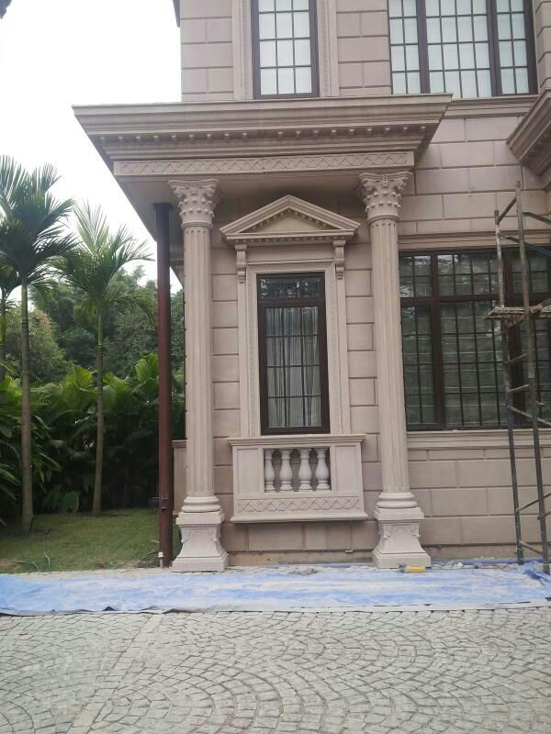
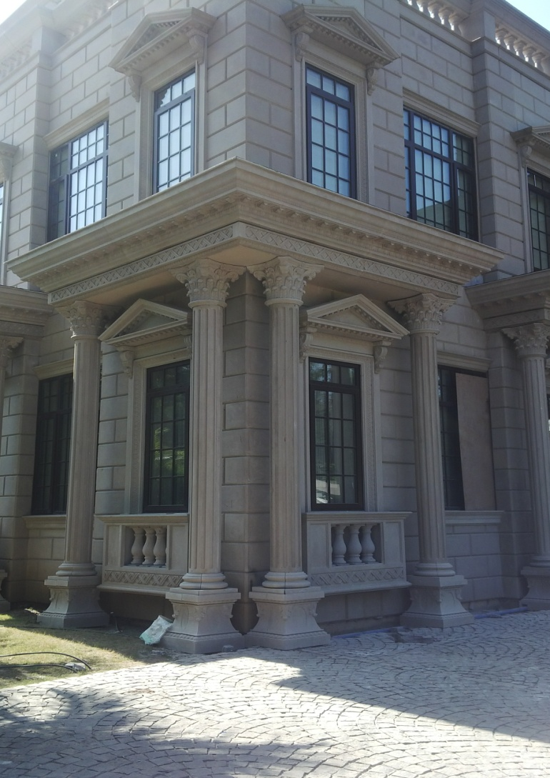
WINDOW SURROUNDS

Slide 3
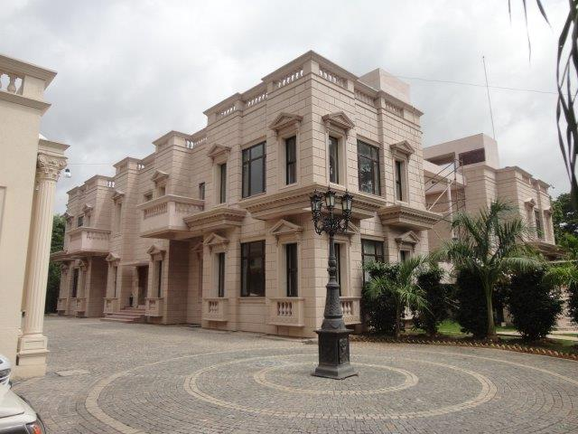
VILLA AT PUNE

Slide 4
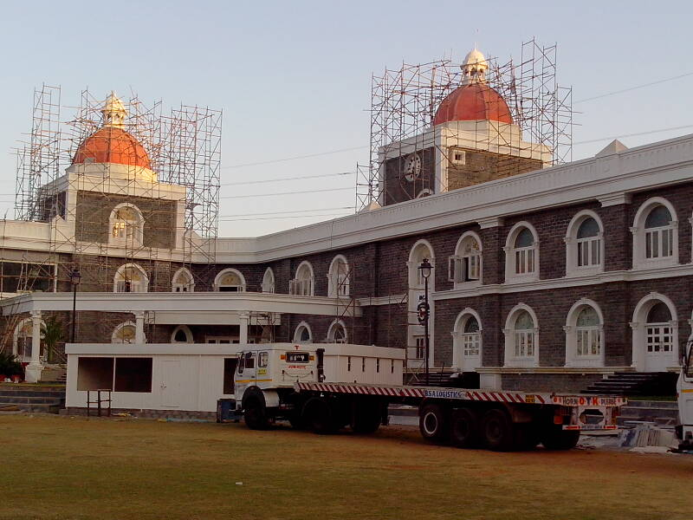
MCA CLUB HOUSE - MUMBAI

Slide 5
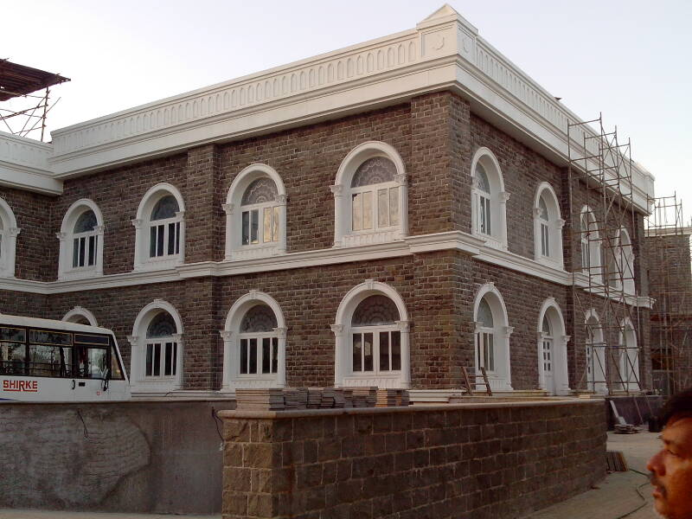
WINDOW SURROUNDS & CORNICE

Slide 6
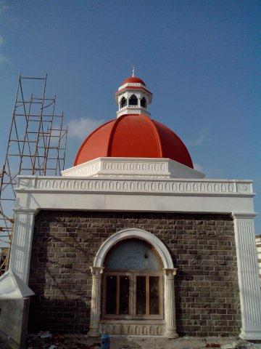
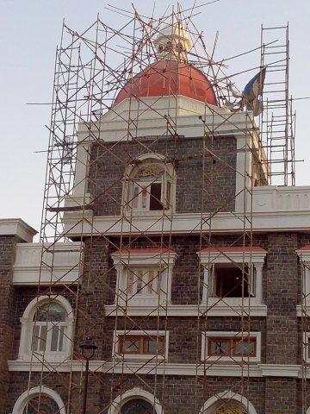
MCA CLUB HOUSE - MUMBAI

Slide 7
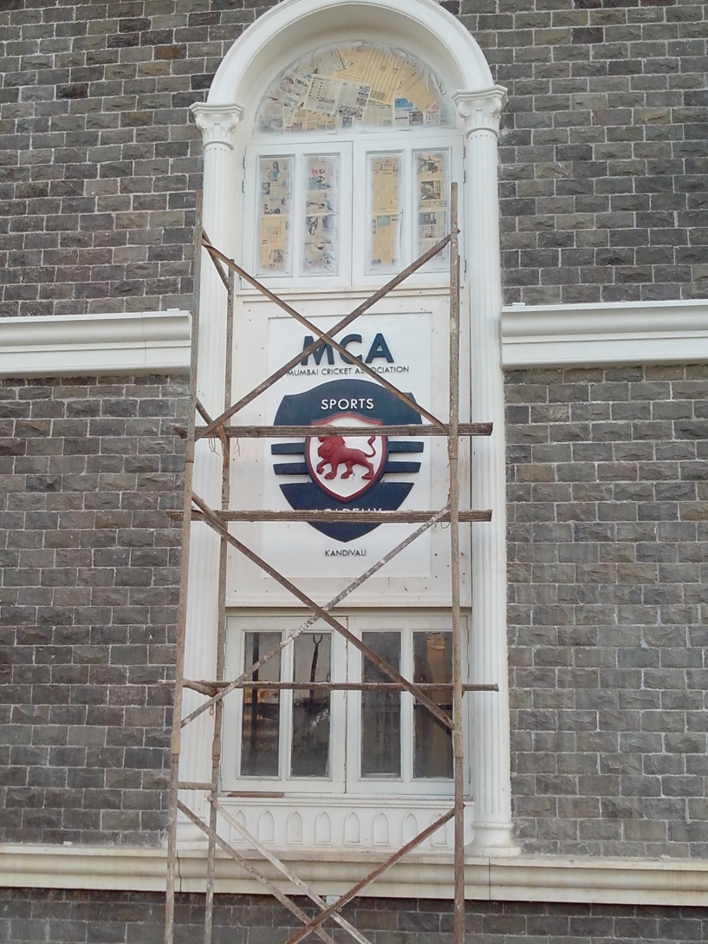


Slide 8
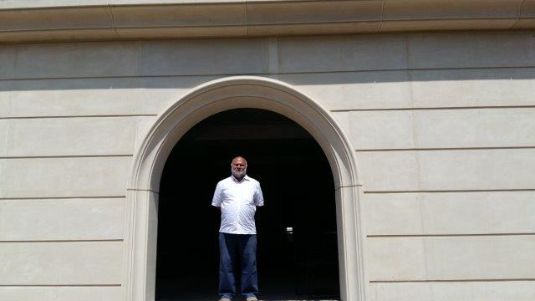
DOOR SURROUND

Slide 9
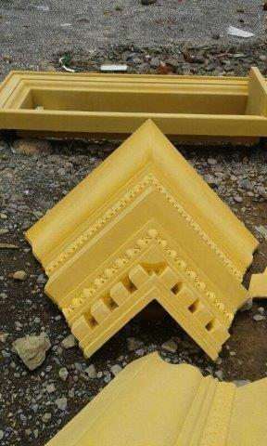
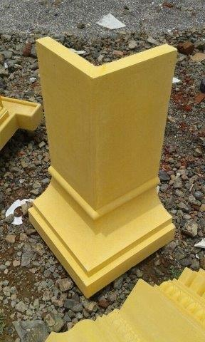
CORNERS OF CORNICE

Slide 10
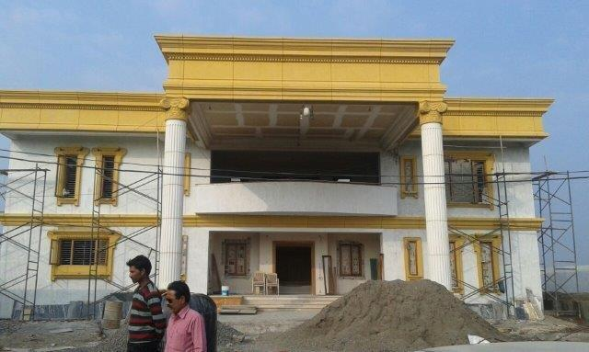
VILLA AT BEED

Slide 11
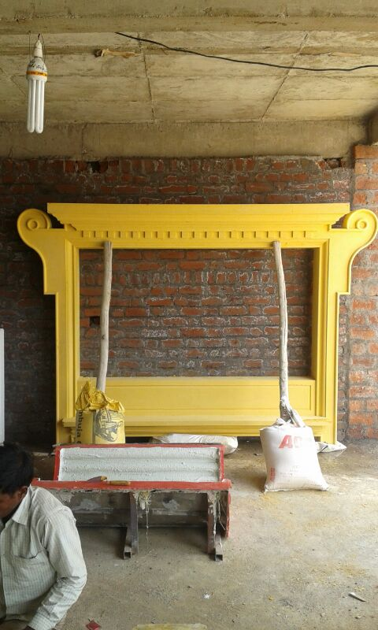
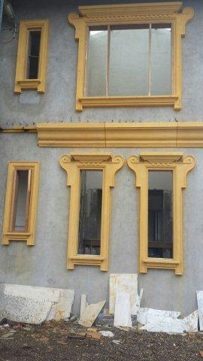

Slide 12
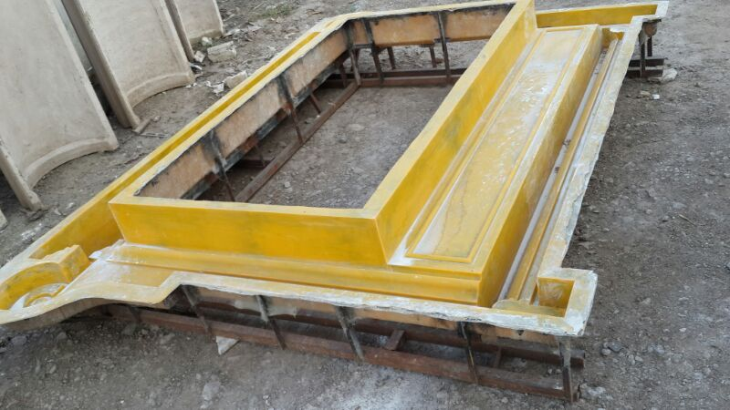

Slide 13
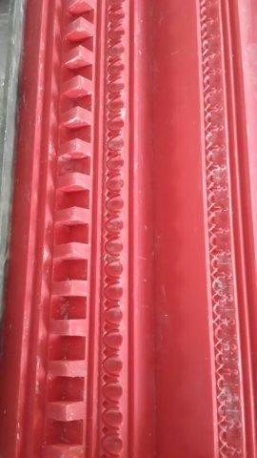
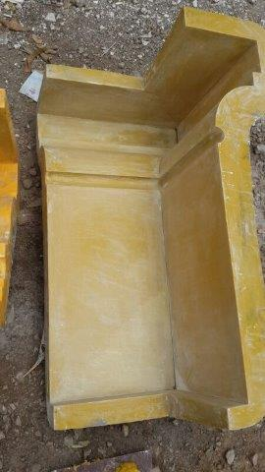
RUBBER MOULD - FIBRE MOULD

Slide 14
CONTACT DETAILS
GFRC FACADES.
GFRC / GRC, GRG CEILINGS & PANELS, FRP WORKS, HIGH END DECORATIVE & ARCHITECTURAL WORKS & ACOUSTIC SOLUTIONS WITH EXPERTISE IN HOME THEATRES
SRIHARI NILKAR
MUMBAI
Mobile: 09867569395
nilkarsrihari@gmail.com

